Slide 1

Design and Analysis of Algorithm
Tanveer Ahmed Siddiqui

Slide 2

Recap
Lecture 2
(Algorithm Design and Analysis Process)

Slide 3
Algorithm Design and Analysis Process
Understand the problem
Decide on : algorithm design techniques etc.
Design an algorithm

Slide 4
Algorithm Design and Analysis Process
Understand the problem
Decide on : algorithm design techniques etc.
Decide on : algorithm design techniques etc.
Design an algorithm
Prove correctness
Analyze efficiency etc.

Slide 5
Algorithm Design and Analysis Process
Understand the problem
Decide on : algorithm design techniques etc.
Decide on : algorithm design techniques etc.
Design an algorithm
Prove correctness
Analyze efficiency etc.
correctness
efficiency
Code the algorithm

Slide 6
Lecture No 3
Correctness of Algorithm
(Proving, Validation and Verification etc.)

Slide 7
Learning Outcomes
After completing this lecture you will be able to understand:
Significance and importance of algorithm correctness
strategies in program/algorithm correctness/ verification
Basic steps in algorithms correctness verification
  Pre- condition and Post-condition
    Examples
  Loop invariant
      Examples

Slide 8
The task of programming a computer is becoming easier when one looks from the viewpoint of variety and capability of the tools available.
However, it is difficult when looked in form the viewpoint of requirements of:
  Correctness.
  Efficiency.

Slide 9
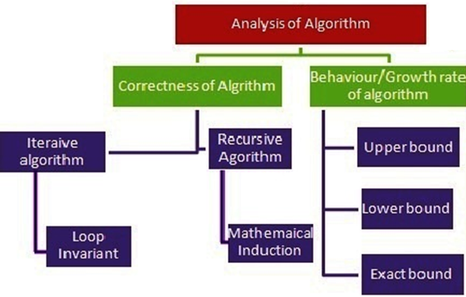
When an algorithm is designed it should be analyzed at least from the following points of view:
Correctness.
Efficiency.

Slide 10
Correctness.
  This means to verify if the algorithm leads to the solution of the problem (hopefully after a finite number of processing steps).
Efficiency.
  This means to establish the number of resources (memory space and processing time) needed to execute the algorithm on a machine (a formal one or a physical one).

Slide 11
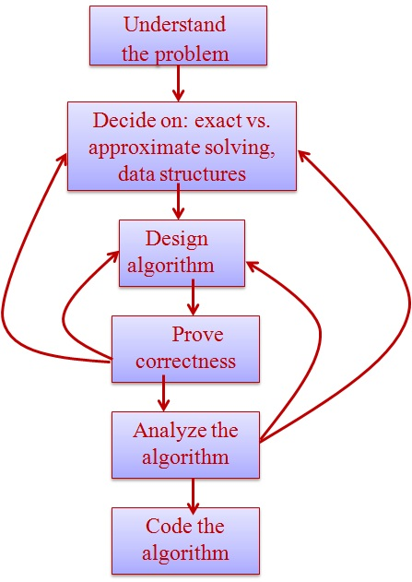
Correctness of algorithm
What does correctness of an algorithm mean?
  for any correct input data:
    it stops and
    it produces correct output.

Slide 12
How to ensure correctness of program/algorithm
In general, one cannot demonstrate the correctness of the program by simply taking each of the possible input data, feeding it to the program, and showing that the result is correct.
  This situation is akin to a foolish boy sent to the market to buy a match box and asked to check the box for any moisture before buying it. The boy went on lighting one match-stick after another, till all were burnt. When asked why he did so, he replied “But then how can I be sure if the other matches will light?”
Unfortunately, the computer programmer, are in the same situation.

Slide 13
Correctness of algorithm
How to ensure the correctness of an algorithm?
How can they be sure that it will not fail on a particular data input?
To verify if an algorithm really solves the problem for which it is designed, we can use one of the following strategies:
  Experimental Analysis (Testing).
    Program testing should be limited to a few data sets only.
  Formal analysis (Proving).

Slide 14
Experimental Analysis
To test a program:
  Testing a program consists of two parts
    Debugging(you are familiar with this concept in programming courses such as Introduction to programming, OOP, data structure)
    Profiling.
An interesting observation about debugging, made by E.W. Dijkstra, a pioneer computer scientist from Netherlands, is worth quoting here: “debugging can only point to the presence of errors and never their absence.”

Slide 15
Experimental Analysis
The program also has to be verified by profiling.
  Profiling is a process of executing a correctly working program with the appropriate data sets and measuring the time and memory space it takes to execute various parts of the program.
  These results are useful in improving the program or even the algorithm.

Slide 16
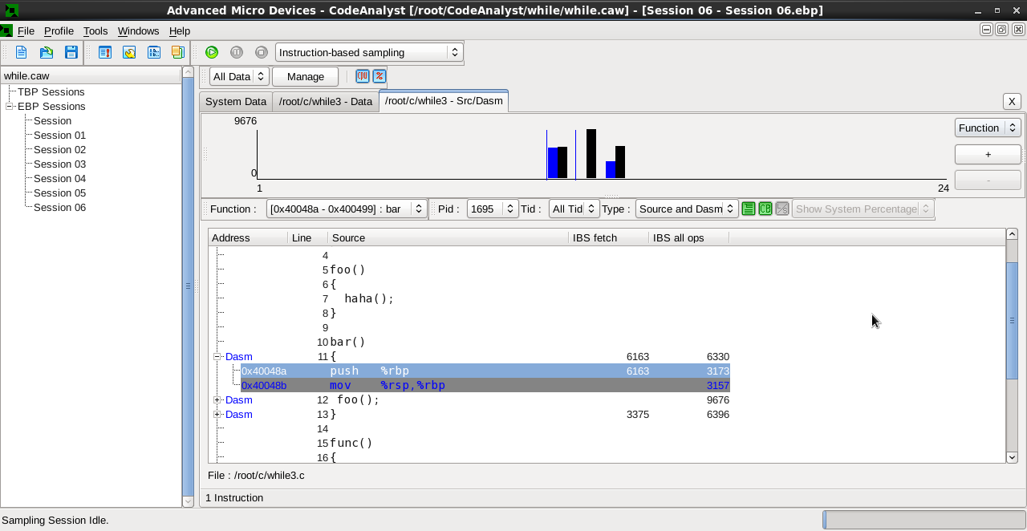
Experimental Analysis

Slide 17
Formal Analysis
To validate an algorithm:
  This means that an algorithm/program satisfies its precise specifications.
  This involves proving the correctness of an algorithm.
Taking the story of the foolish boy a little further, he could have argued that if the box had absorbed moisture, then there was a good probability that all the match-sticks would be equally moist.
So, if he had tasted any one of them, it should tell him about the whole box.
Thus, he could have used limited testing plus proof instead of exhaustive testing.

Slide 18
Correctness of algorithm
In this course, we shall discuss the basics of such proofs for algorithm/program.
Note: Once an algorithm is shown to be correct, only then should the program coding begin.

Slide 19
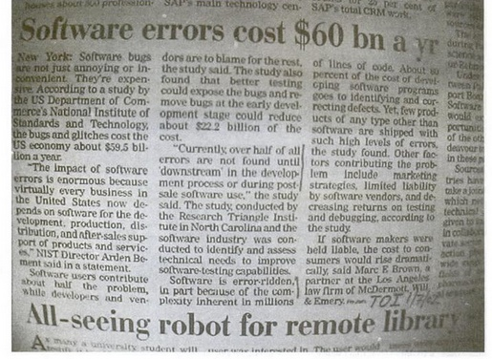
Significance and importance of algorithm correctness
Why there is so much concern about program correctness?
Software errors are costly
  There are many application where an erroneous program/algorithm can lead to loss of money( Fig 1)
  Source : Times of India, July 2001

Slide 20
Significance and importance of algorithm correctness
There are many situations where safety to human life is involved, like in medical applications, or industrial safety systems, atomic power plants, manned space flights, and so on.
In these applications, program/algorithm correctness has to be guaranteed.
  Imagine what will happen if the computer inside Ghouri missile has an unreliable program due to which the missile goes hay wire – it may turn around and strike its own city rather than the enemy site!

Slide 21





Correctness of algorithm
How to ensure correctness of an algorithm?
Correctness of Algorithm
Iterative Algorithm
Recursive Algorithm
Loop Invariant
Mathematical Induction

Slide 22
Basic steps in algorithms correctness verification
The main steps in the formal analysis of the correctness of an algorithm are:
Identification of the properties of input data(I) (the so-called problem's pre-conditions).
Identification of the properties which must be satisfied by the output data(O) (the so-called problem's post-conditions).
Proving that starting from the preconditions and executing the actions specified in the algorithms one obtains the post-conditions. i.e. proving I O

Slide 23
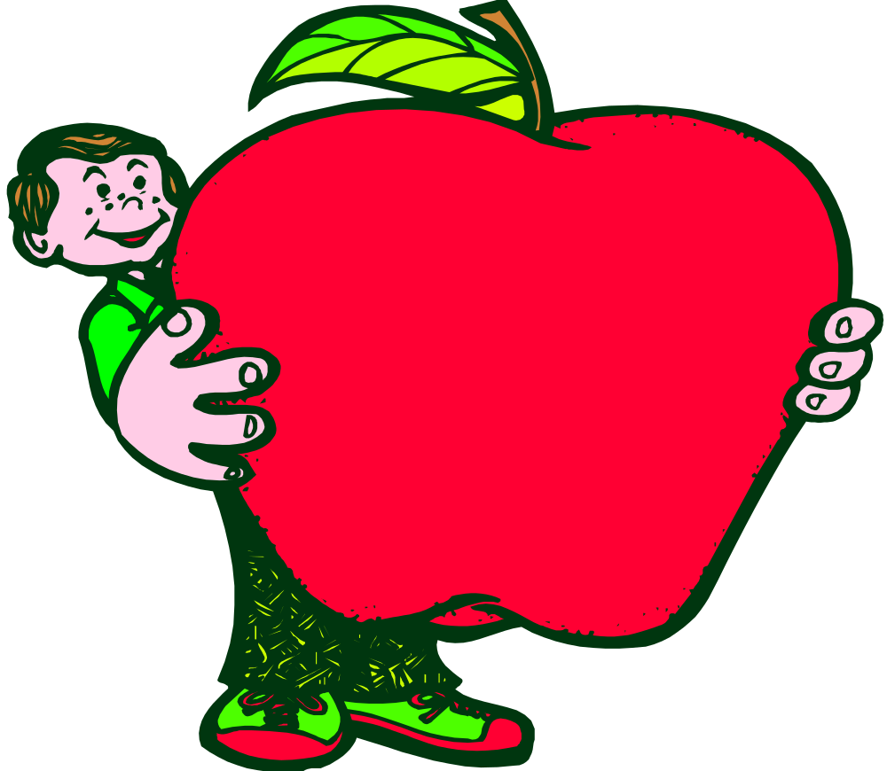
Pre- condition
and
Post- condition

Slide 24
Predicate
A predicate is a sentence that contains a finite number of variables.
The domain of a predicate variable is the set of all values that may be substituted in place of the variable.
Example: Consider the sentence
“Aslam is a student at COMSATS ISLAMABAD.”
Let P:“is a student at the COMSATS ISLAMABAD”
Let Q: “is a student at.”
Then both P and Q are predicate symbols.

Slide 25
Predicate
The sentences “x is a student at the COMSATS ISLAMABAD” and “x is a student at y” are symbolized as:
P(x): x is a student at the COMSATS ISLAMABAD”
Q(x, y): x is a student at y”
where x and y are predicate variables and take values in appropriate sets.
When concrete values are substituted in place of predicate variables, a statement results.
When we analyze the correctness of an algorithm a useful concept is that of state.
  The algorithm's state is the set of the values corresponding to all variables used in the algorithm.

Slide 26
Pre conditions and Post conditions
PRE-CONDITIONS
  The predicate describing the initial state is called the pre-condition of the algorithm.
  It indicates what must be true before the algorithm start.
    Precondition: a predicate I on the input data
POST-CONDITIONS
  The predicate describing the final state is called the post-condition of the algorithm.
  It indicates what will be true when the algorithm finishes its work.
    Post condition: a predicate O on the output data

Slide 27
Precondition/Postcondition
Suppose that you are the head of a programming team. Your team is writing a large piece of software, perhaps with millions of lines of code.
Certainly, nobody can keep all those lines of code in their head at once.
So, the large problem is broken into smaller problems. Those smaller problems might be broken into still smaller problems, and so on, until you reach manageable problems.
Each of the manageable problems can be solved by a module/function but you won't be writing all these modules/functions.

Slide 28
Pre and Post conditions
The modules/functions are written by members of your team. As each team member is given a module/function to write, you will specify the requirements of the module/function by indicating what the function must accomplish. But most of the details about how a module/ function work will be left up to the individual programmers.
Consider an algorithm that is designed to produce a certain final state from a given state. Both the initial and final states can be expressed as predicates involving the input and output variables.
There are many ways to specify the requirements for a module/function. In this lecture we will use a pair of statements for each algorithm, called the algorithm's precondition and post condition.

Slide 29
Example 1
Algorithm to compute square root of nonnegative integers
  What needs to be true so that Algorithm successfully carry out its work?
  Since negative numbers don't have a square root, we need to ensure that the argument, x, is not negative.
  This requirement is expressed in the precondition
  Pre-condition: x ≥ 0.
  The post condition is simply a statement expressing what work has been accomplished by the function.
  Post-condition: The square root of x has been written to the standard output.

Slide 30
Example 2
Algorithm to compute a product of two nonnegative integers
  Pre-condition: The input variables m and n are nonnegative integers.
  Post-condition: The output variable p equals m · n.
Algorithm to find the quotient and remainder of the division of one positive integer by another
  Pre-condition: The input variables a and b are positive integers.
  Post-condition: The output variable q and r are positive integers such that a = b · q + r and 0 ≤r < b.

Slide 31
Pre and Post conditions of a sorting algorithm
What are the pre-condition and post condition of a sorting Algorithm
  Pre-condition: The input variable A[1], A[2], . . . A[n] is a one-dimensional array of real numbers.
  Post-condition: The input variable B[1], B[2], . . . B[n] is a one-dimensional array of real numbers with same elements as A[1], A[2], . . . A[n] but with the property that B[i] ≤B[j] whenever i ≤ j.

Slide 32
Loop Invariant

Slide 33
Loop invariants
Loop Invariant:
Property of loop that does not change
      A loop is said to work correctly with respect to its pre-conditions and post-conditions iff, whenever the algorithm variables satisfy the pre-condition for the loop and the loop is executed, then the algorithm variables satisfy the post-condition of the loop.
      A loop invariant is a predicate such that: if it is satisfied before entering any single iteration of the loop then it is also satisfied after the iteration.

Slide 34
Loop Invariant
Let n denote the number of iteration of a loop.
Let P(n) be a predicate.
A relationship among the variables hold true before the loop is executed and after each iteration of the loop, no matter how large n is. As the algorithm execution progresses, the values of the variables in the loop may vary, but the relationship remains unaffected. Such a predicate is a loop invariant.
A loop invariant is a statement about program variable that is:
  true just before a loop begins executing.
  Also true after each iteration of the loop.

Slide 35
Loop invariants
Remarks:
      Induction hypothesis = loop invariant = relationships between the variables during loop execution.
Finding invariants implies to carefully write the input/output of the algorithm

Slide 36
Loop invariants
Good practice define Loop invariant:
  Write carefully the pre-conditions and post-conditions of the loop.
  Write statement that captures the purpose of the loop
  Try to find relationship among the variables that hold true
    just before a loop begins executing.
    after each iteration of the loop.
    after the loop finishes.
  Call this relationship P(n) where n denote the number of iteration of a loop.

Slide 37
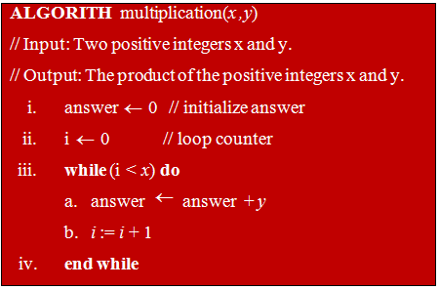
Reasoning of Proof
Example 1
What are the
  Pre-Condition
  Post- Condition
  Loop Invariant
For the following Algorithm

Slide 38
Example 1
Trace Table for Multiplication Algorithm
Iteration # | Action | a_{n} | i_{n}
0 | Initial | a₀ = 0 | i₀ = 0
1 | Result of Step 3(a) | a₁ = a₀+ y a₁ = 0+ 5 = 5
 | Result of Step 3(b) |  | i₁ = i₀ +1 i₁ = 0+1 =1
a₁ = 5* 1 = y* i₁
2 | Result of Step 3(a) | a₂ = a₁+ y a₂ = 5+ 5 = 10
 | Result of Step 3(b) |  | i₂ = i₁ +1 i₂ = 1 +1 =2
a₂ = 5* 2 = y* i₂
3 | Result of Step 3(a) | a₃ = a₂+ y a₃ = 10+ 5 = 15
 | Result of Step 3(b) |  | i₃ = i₂ +1 i₃ = 2 +1 =3
a₃ = 5* 3 = y* i₃
4 | Result of Step 3(a) | a₄ = a₃+ y a₄ = 15+ 5 = 20
 | Result of Step 3(b) |  | i₄ = i₃ +1 =1 i₄ = 3 +1 =4
a₄ = 5* 3 = y* i₄
Result | answer = 20

Slide 39
Example 1
Induction Examples (4/4)
3.3 Mathematical Induction
Pre-Condition: x is a nonnegative integer, y is a nonnegative integer, i = 0, and answer = 0.
Post-Condition: answer = x · y
Loop Invariant: Let a_{n} and i_{n} denotes the values of answer and i at the end of n iterations.
Let P(n): a_{n} = i_{n} . y, n≥ 0

Slide 40
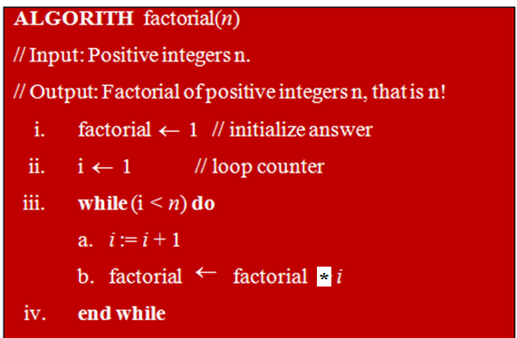
Example 2: Factorial of positive integer
What are the
  Pre-Condition
  Post- Condition
  Loop Invariant
For the following Algorithm

Slide 41
Example 2: Factorial of positive integer
Induction Examples (4/4)
3.3 Mathematical Induction
Pre-Condition:
  n is a nonnegative integer, i = 1, and factorial = 1.
Post-Condition:
  factorial = n!
Loop Invariant:
  Let fact(n) be the value of factorial at the end of n iterations of the loop, then
  P(n): fact(n) = n!, n≥ 0
  be the loop invariant

Slide 42

Example: Loop Invariant for Sum of n numbers
Algorithm Sum_of_N_numbers
Input: a, an array of N numbers
Output: s, the sum of the N numbers in a
s:=0;
k:=0;
While (k<N) do
k:=k+1;
s:=s+a[k];
end
Loop invariant = At step k, S holds the sum of the first k numbers

Slide 43
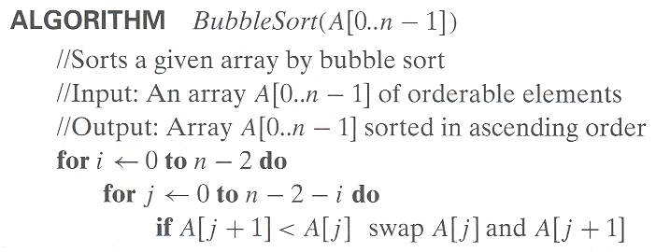
Example 3: Bubble Sort
Pre- Condition:
The input variable A[1], A[2], . . . A[n] is a one-dimensional array of real numbers.
Post- Condition:
The input variable B[1], B[2], . . . B[n] is a one-dimensional array of real numbers with same elements as A[1], A[2], . . . A[n] but with the property that B[i] ≤B[j] whenever i ≤ j.
Loop Invariant:
  Let P(n) = The algorithm
  sorts every list of size n ≥ 1

Slide 44
Conclusion
One of the most difficult requirement to satisfy is to show that a program/algorithm works correctly, outputting the expected behavior and results in the range of data that it is required to handle.
Program testing should be limited to a few data sets only.
In general, the program/algorithm has to be proved to be correct by some other means.

Slide 45
Conclusion
PRE-CONDITIONS
  The predicate describing the initial state is called the pre-condition of the algorithm.
  It indicates what must be true before the algorithm start.
    Precondition: a predicate I on the input data
POST-CONDITIONS
  The predicate describing the final state is called the post-condition of the algorithm.
  It indicates what will be true when the algorithm finishes its work.
    Post condition: a predicate O on the output data

Slide 46
Conclusion
A loop invariant is a logical predicate such that: if it is satisfied before entering any single iteration of the loop then it is also satisfied after the iteration.
A loop invariant is a statement(relationship among the variables ) about program variable that is:
    just before a loop begins executing.
    after each iteration of the loop.
    after the loop finishes.
Ideally, this predicate tells us that the loop produces the expected result, i.e. that the loop is correct.

